Slide 1
Quantitative Biological Research with Python (92847)
TA 8 – Visualization

Slide 2
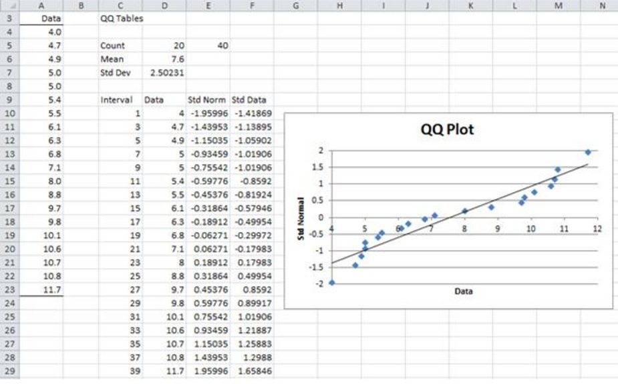
Why not just using Excel?
Excel provides a simple GUI interface
But it’s limited
Requires transferring the obtained data (e.g. via CSV)
  More time will pass between doing the analysis and seeing the results
Latency is crucial for interactive research
We want a Python library that plots the results as we obtain them

Slide 3
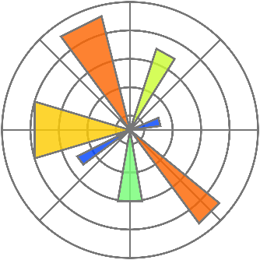
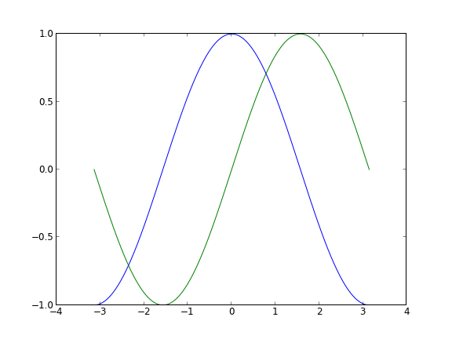
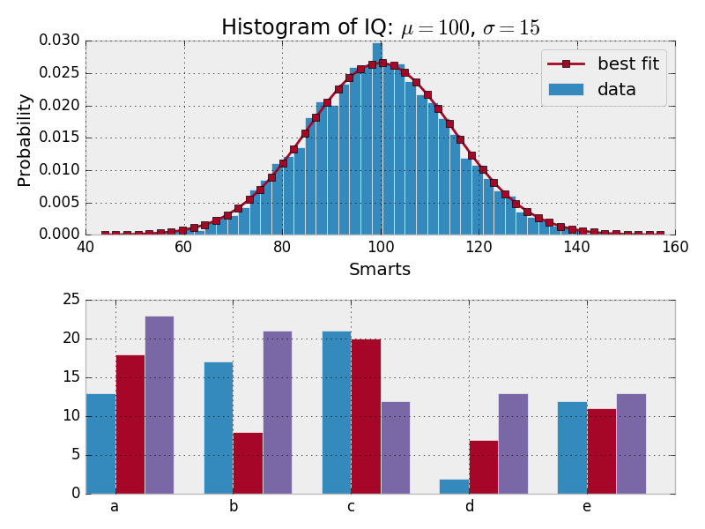
Matplotlib
The standard Python plotting library
Provides a MATLAB-like interface, uses Numpy
Good integration with Jupyter; shortcuts in Pandas
Pros:
  Very common (many users, questions and answers)
  Highly flexible (you can draw pretty much everything)
  Simple charts are simple to make
  Can design good-looking graphics
Cons:
  Over-complicated (and inconsistent) API
  Documentation could be better
  Complex charts are sometimes hard to make
  The default design is not that beautiful

Slide 4
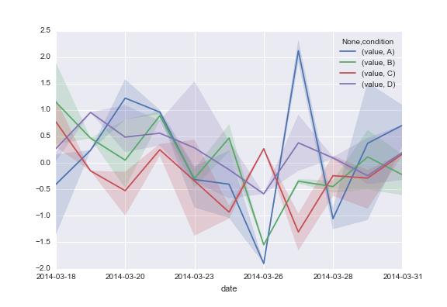
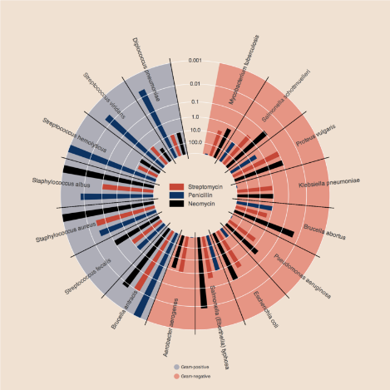
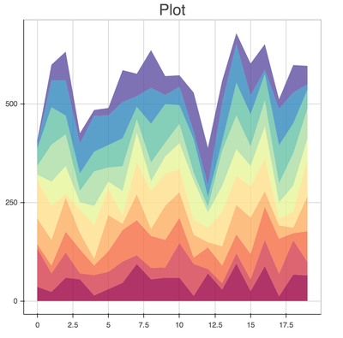
Other alternatives
Seaborn
  Based on Matplotlib
  Coupled with statistical data processing
Bokeh
  Provides interactive plots (via JavaScript)
Both provide more attractive default styles than Matplotlib, but are more limited and less commonly used. APIs are also not that great.
There are more…

Slide 5
Know your variables
All charts essentially illustrate the relationships between some variables
In order to choose the right type of chart, you need to know:
  How many variables there are to visualize
  Whether each variable is numeric or categorical
Although most charts are 2D, more variables can be packed in using various tricks (e.g. colors, shapes, sizes)

Slide 6
Types of charts

Slide 7
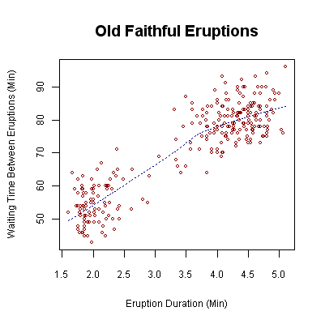
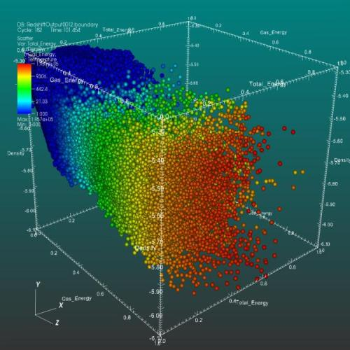
Scatter plot
Just a set of points, given by x-y(-z) coordinates
Trendlines are sometimes added
Points can be color-coded or vary in size and shape
Axes can be transformed (e.g. log)
Appropriate when all variables are numeric
Always important to notice:
  What do the axes stand for?
  What does each point represent?
  What transformations & filters have been applied on the data

Slide 8
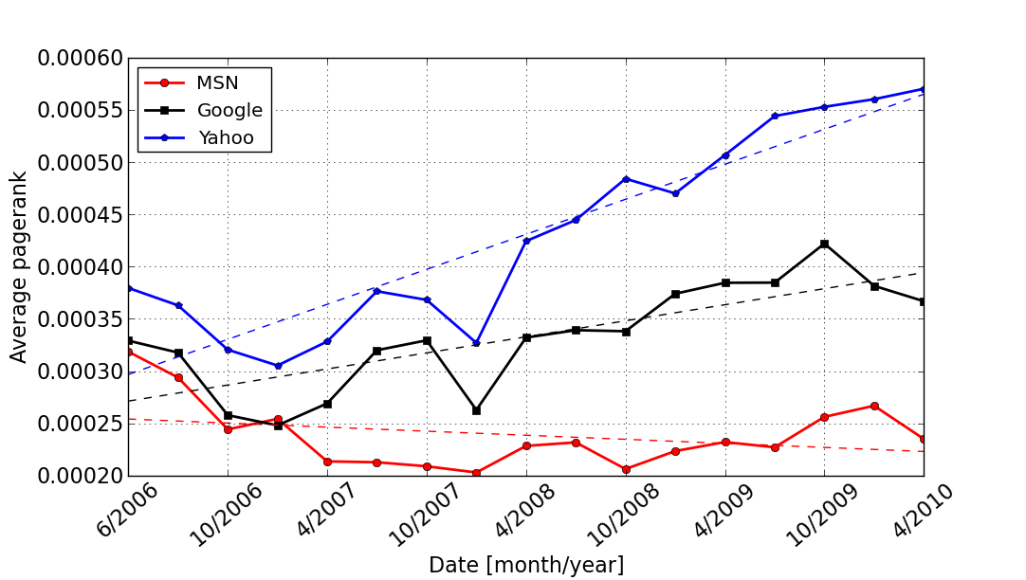
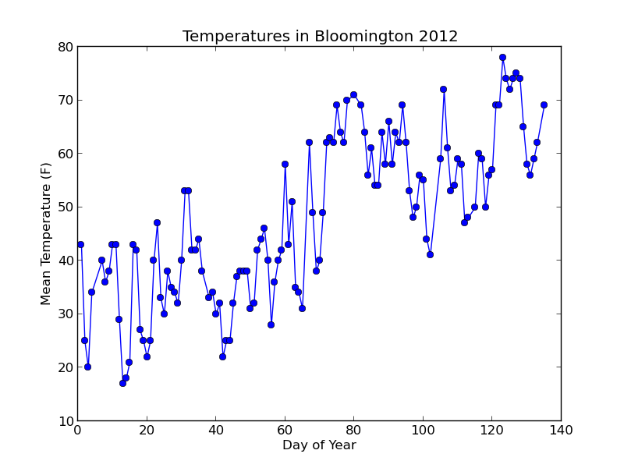
Line chart
A scatter plot with the points (“markers”) ordered and connected by lines
Appropriate only if Y is believed to be a continuous function of X
  Otherwise will just be a mess
Very common where X represents time

Slide 9
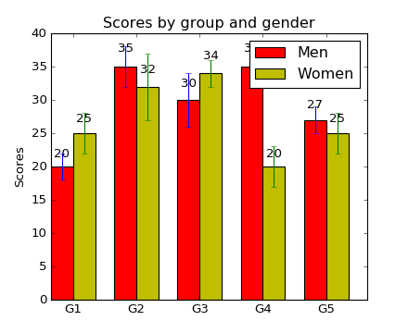
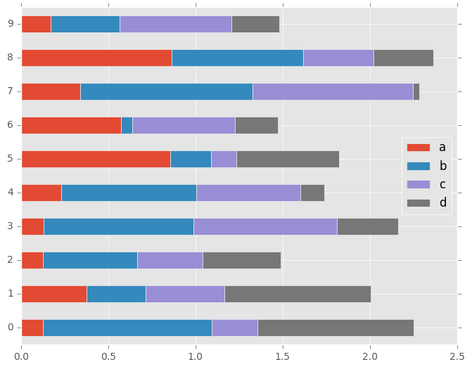
Bar chart
Represents relationships between categorical variable(s) (groups) to a numeric variable
Categories can be side by side, or stacked on top of each other
Error bars can be added to represent uncertainty (e.g. standard deviation or confidence interval)

Slide 10
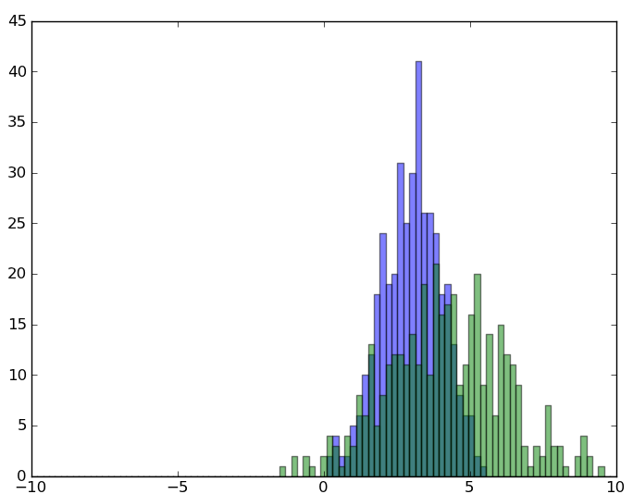
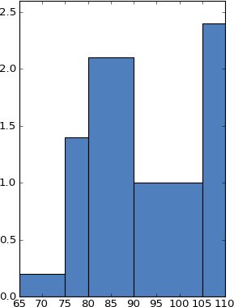
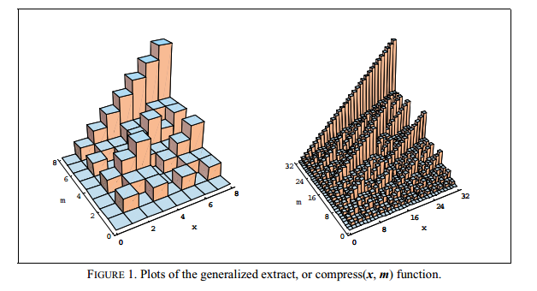
Histogram
Represents the distribution of a numeric variable
First “binning” the data, and then counting the number of values falling into each bin
Bins are usually (but not necessarily) of equal size
Y axis can be normalized to show frequencies, or left to show absolute values
When normalized, the total area (not sum!) should equal 1
  Important with unequal bin sizes, and when combined with density function

Slide 11
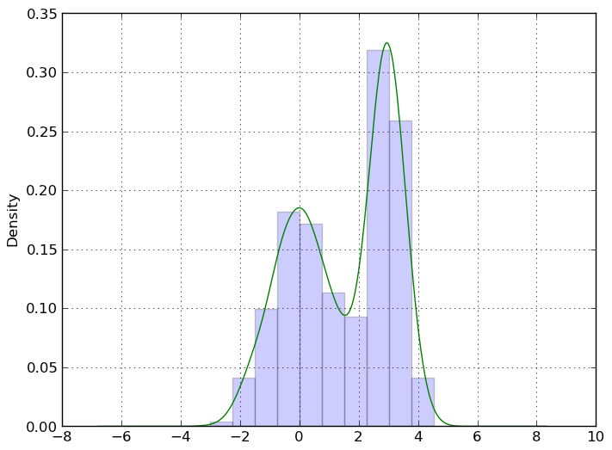
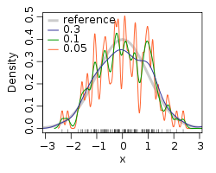
Density plot
Tries to reconstruct the density function of a continuous distribution
A smooth version of histogram; the two are often combined
Relies on extrapolation, usually with kernels (assuming the density function is of some form)
  More decisions need to be made than with histograms

Slide 12
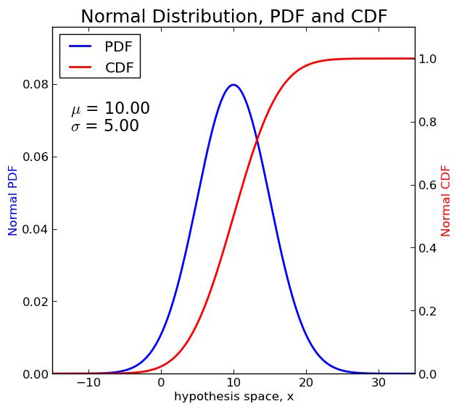
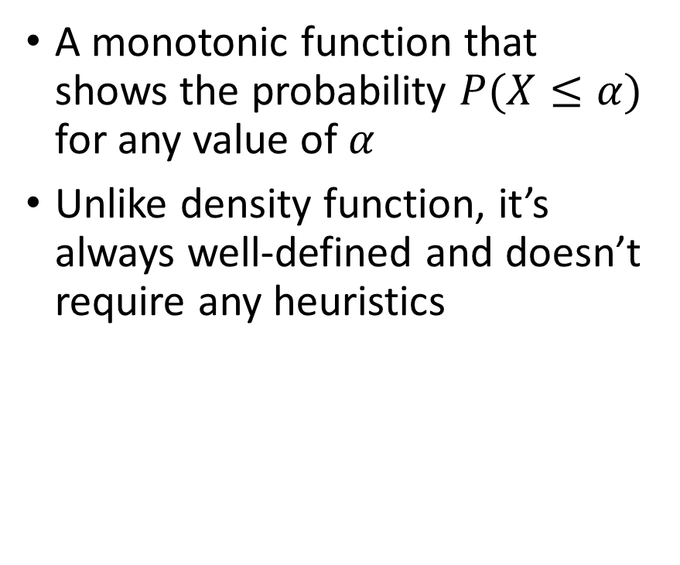
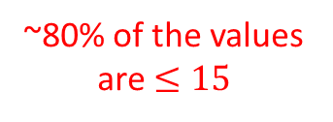
Cumulative Distribution Function (CDF)
A monotonic function that shows the probability $P(X≤α)$ for any value of $α$
Unlike density function, it’s always well-defined and doesn’t require any heuristics
~80% of the values are $≤15$

Slide 13
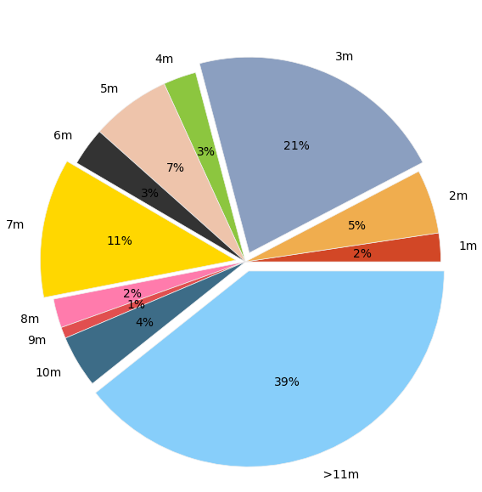
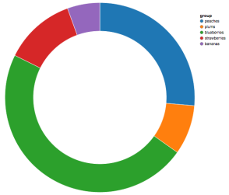
Pie chart
Distribution of a categorical variable
Can be labeled with percentages or absolute values
Groups can be “exploded” for emphasis
Quite limited
Can be replaced by bar charts

Slide 14
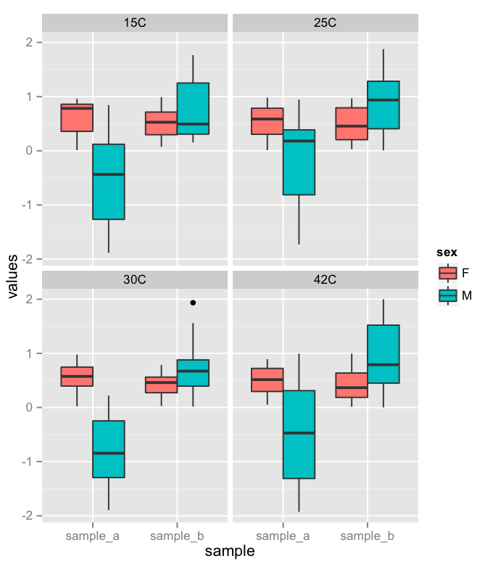
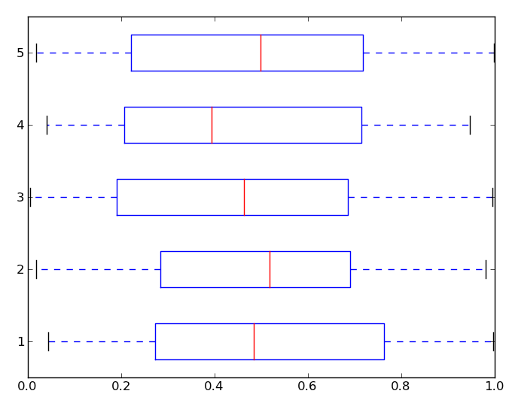
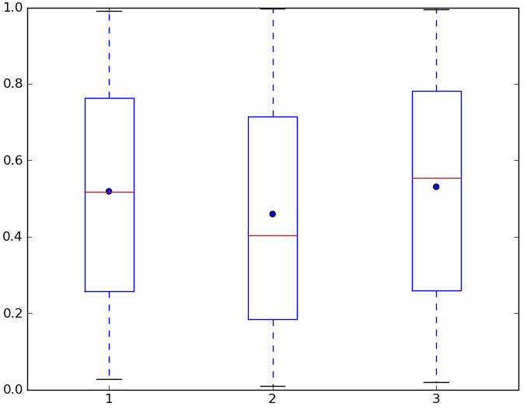
Box plot
Like histograms and density plots, describes the distribution of a numeric variable
The box outlines the main measures of a distribution:
  Median (Q2)
  First and third quartiles (Q1 & Q3)
    Indicates IQR (Q3 – Q1)
  Mean (optionally, as a dot)
Whiskers can indicate many things, including:
  Global min & max
  Lowest & highest value within 1.5 IQR of Q1 & Q3
  1 std below and above the mean
  9th-91st or 2nd-98th percentiles
Values outside of the whiskers are usually plotted as outliers

Slide 15
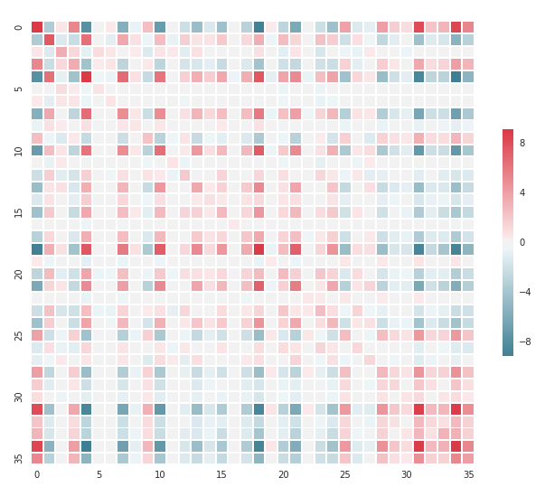
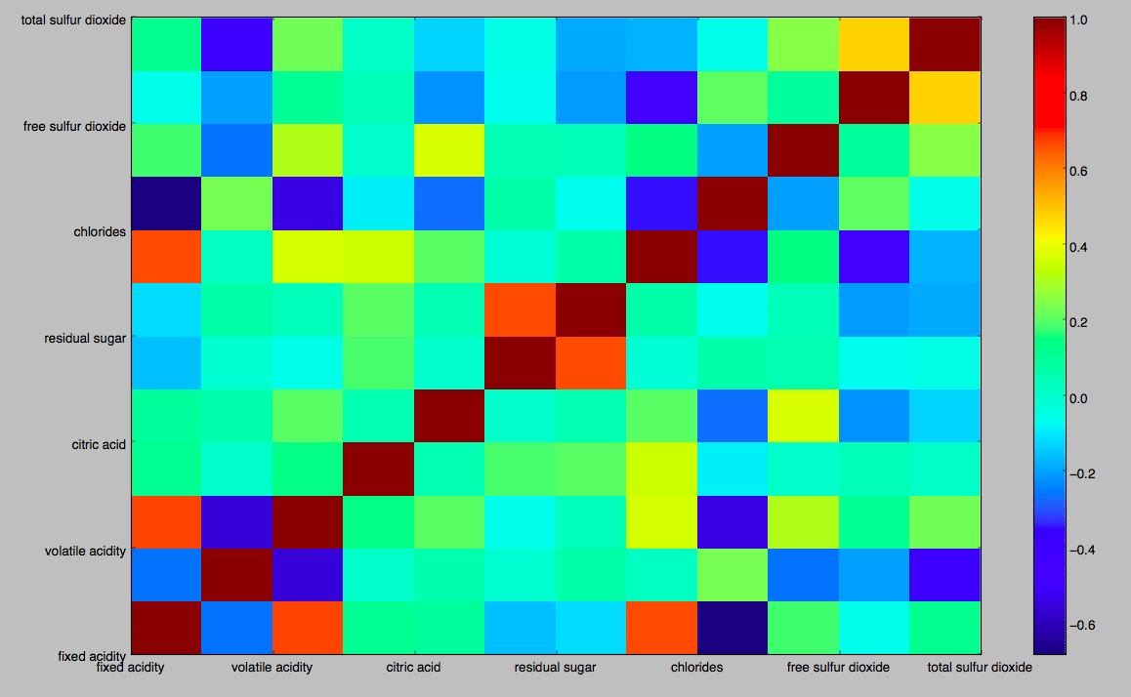
Heat map
A matrix of colors
Represents a numeric variable depending on two (usually discrete) variables
  Avoids 3D graphs
Important to choose a simple color map and display it
Very commonly used for:
  Similarity/distance matrix
  Gene expression (of different genes and samples)

Slide 16
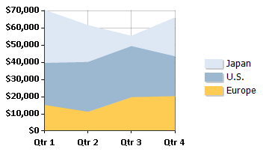
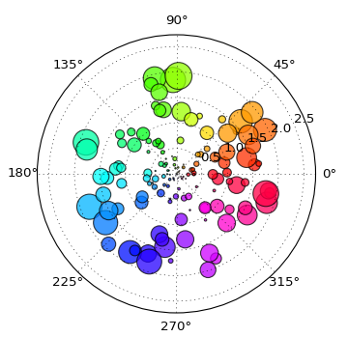
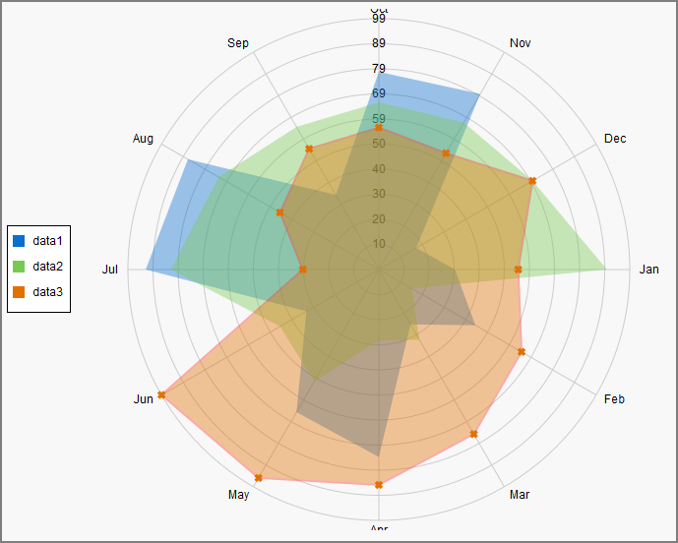
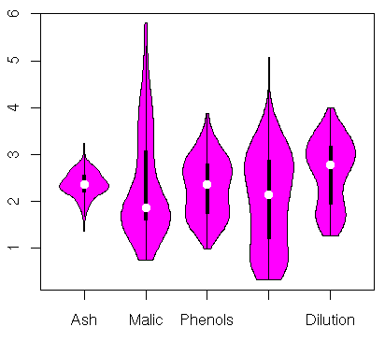
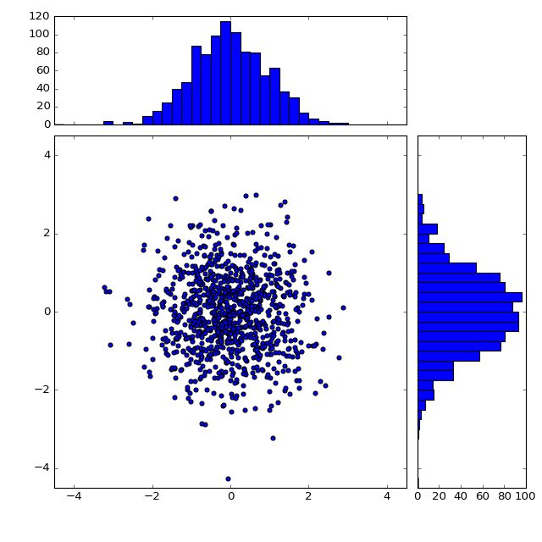
More types
Area chart
Radar chart
Polar chart
Violin plot
Scatter + histograms

Slide 17
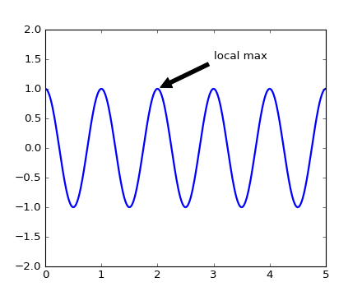
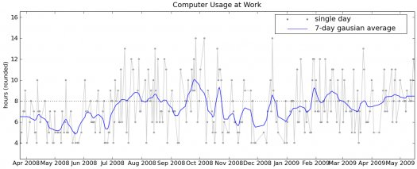
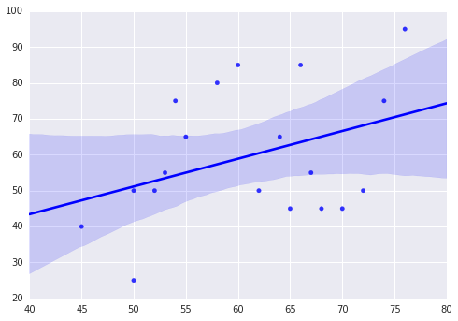
More visual aids
Texts & arrows
Lines
Confidence area

Slide 18
Caveats
Handle outliers with care
  Get rid of them only if they really cannot be accommodated in the graph, not just to make your proposition more convincing
  Indicate their removal on the caption
Same goes for data transformations (e.g. log scale)
Sight can be misleading
  Our brains often see patterns where there’s just noise
  Important to combine visual aids with rigorous statistics (we’ll get to it…)

Slide 19
Let’s get started
Example gallery: http://matplotlib.org/gallery.html
User’s guide: http://matplotlib.org/users/index.html
API: http://matplotlib.org/api/index.html

